Slide 1
Batch Unique ID 2021ee35

Slide 2
Distribution Line Monitoring and Controlling
Guided By:
Ms.A.Shinisha
By
ALTHAF RAZACK L A (171EE110)
ARUN BABU M (171EE112)
HARIHARAN M K (171EE145)

Slide 3
Literature Survey
Abdul Khaliq, Distribution Transformers have a long service life if they are operated under rated conditions. However, their life is significantly reduced if they are overloaded, resulting in unexpected failures and loss of supply to a large number of customers thus effecting system reliability.
Amutha Elizabeth, The efficiency of power systems is largely determined by the effectiveness of the inbuilt power equipment.

Slide 4
Aim of the Project
To design real time visualization, monitoring and controlling of electrical distribution system using Microcontroller.
To find the fault in distribution line i.e., Fault Detection.

Slide 5
Scope of the Project
It always monitors the current and voltage, if any deviation occurs it alerts the sub-station workers i.e., Anti-theft
Controls the entire distribution line in any remote area.
Prevents the accidents during rainy season.

Slide 6
Need of the Current Study
The entire world is evolving with new technologies and IoT is the current trend.
To encourage digital India we want to promote IoT in Distribution line also.
There are many IoT solution providers who can help you experience IoT based home automation.

Slide 7
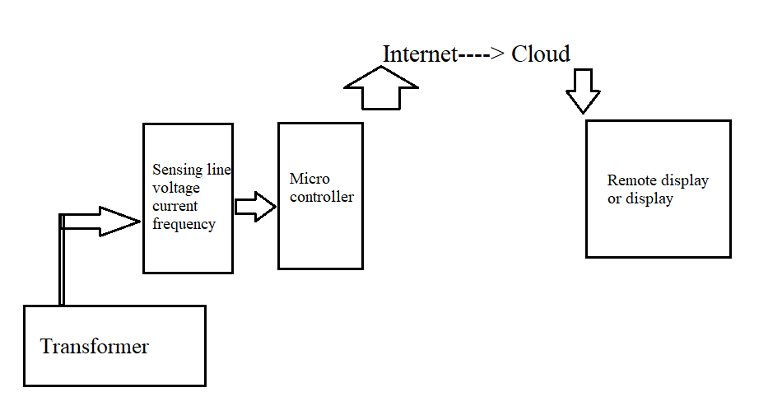
Feasibility Analysis

Slide 8
Proposed Methodology
This is used to detect fault and send a SMS alert using the GSM network once the fault is detected. It receives the perceived parameter during power transmission, detect breach in short circuit limit set by comparing the current sensed with the pre-set limit.
If the current sensed is more than the pre-set current short circuit limit, the GSM module sends a signal for the relay to trip off the system, else the system remains connected. When the relay trips of the system, an SMS alert is sent to the utility mobile phone via the GSM network.

